Slide 1



Scientific Revolution and Enlightenment
1) Understand the scientific method advanced by Bacon and Descartes, the influence of new scientific rationalism on the growth of democratic ideas, and the coexistence of science with traditional religious beliefs.
Lesson objectives
Teachers' notes

Slide 2

Scientific Revolution and Enlightenment
2) Students analyze the historical developments of the Scientific Revolution and its lasting effect on religious, political, and cultural institutions.
3) Discuss the roots of the Scientific Revolution
4) Understand the significance of the new scientific theories
Lesson objectives
Teachers' notes

Slide 3

Subject:
Topic:
Grade(s):
Prior knowledge:
Cross-curricular link(s):
Western Civilization
Scientific Revolution and Enlightenment
10th
Basic
All kinds
Lesson notes:
Type text here
Lesson objectives
Teachers' notes

Slide 4

The Beginning of the Scientific Revolution
Pull
The Causes of the Scientific Revolution
A change at how Europeans looked at themselves
Technological changes
Shift in belief away from ancient authorities
Observation in the natural world priority
Mastered Latin and Greek allowing greater exposure to Ptolemy and Archimedes who questioned aristotle

Slide 5
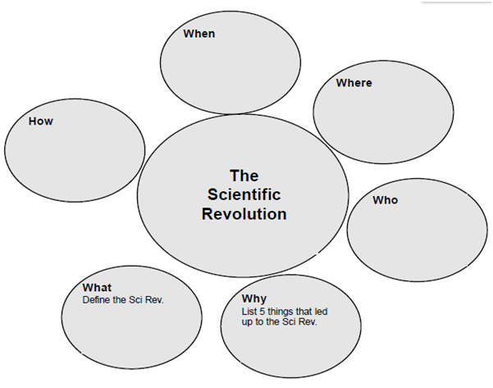

Slide 6
The Beginning of the Scientific Revolution
Here we take a closer look at the CAUSES of this revolution
Discuss the roots of the Scientific Revolution (Greek rationalism; Jewish, Christian, and Muslim science Renaissance humanism; new knowledge from global exploration).
Pull
1. Greek rationalism ..............The Greeks used reason and logic to figure out scientific explanations.
The ancient Greeks were great scientists.
Pull
Why the Greeks were great
The Greeks were the first to ignore superstition and give scientific explanations to events.
Example: Hippocrates ignored superstition and explained that a disease has a specific cause.

Slide 7
The Beginning of the Scientific Revolution
Aristotle’s method
Aristotle developed his own method:
1. Use observation - Use your own eyes. Don’t rely on “accepted wisdom” (religion and superstition).
2. Classify information - Break it down into its parts.
3. ANALYZE - Examine the parts and their relationship to one another.
4. Draw conclusions - using DEDUCTIVE
Pull
The Greek method sometimes went astray
Some Greek theories were just plain wrong . . .
Aristotle: Heavy objects fall faster than lighter objects.
Ptolemy: The sun and planets revolve around the Earth.
What was missing
Run an experiment to test your theory!
Pull

Slide 8
The Beginning of the Scientific Revolution
2. Muslim Science
Muslim Math
Modern math began when Arabic numerals were introduced in Europe
Muslim Science
Muslim scholars preserved the Greek books on science
Avicenna's Cannon of Medicine was the standard medical book in Europe for 600 years
What was missing?
Run an experiment to test your theory
Pull

Slide 9
The Beginning of the Scientific Revolution
3. Religion
Jewish and Christian scholars
Both Maimonides (Jewish scholar) and St. Thomas Aquinas (Christian scholar) agreed:
1. Aristotle’s logic and reasoning was the way to go.
2. There is no conflict between reason and faith.
3. It’s okay to study science - it will not conflict with religion.
Protestant Reformation
Reformation leaders (Martin Luther) discarded traditional ideas.
They had no problem with the Scientific Revolution.
Pull

Slide 10
The Beginning of the Scientific Revolution
4. Renaissance humanism
Humanists explored new ideas in every field.
Copernicus
Copernicus, born in Poland, was a world-famous astronomer.
His book: On the Revolutions of the Heavenly Spheres (1543).
Pull
Ptolemy (the ancient Greek astronomer) said:
The earth is at the center of the universe. The sun revolves around the earth.
Copernicus said: The sun is at the center of the universe.
For his Copernican theory, he is regarded as the “Father of Modern Astronomy.”
Pull

Slide 11
The Beginning of the Scientific Revolution
5. The Age of Exploration
New knowledge from global exploration
Christopher Columbus had a theory: If I sail west, I should land in Asia.
In 1492, he conducted an experiment to test his theory.
He was dead wrong:
There were two continents (North & South America) that Europeans did not know about.
This made scientists throw “accepted ideas” out the
Pull
Scientific Inventions
As you tell the story, students draw four cartoons.
During the 1600s, scientists invented precision instruments to improve their ability to observe and measure.
Pull

Slide 12
The Scientific Revolution!
Galileo lived from 1564 to 1642
The Scientific Revolution was in full swing in the 1600s.
The Beginning of the Scientific Revolution
Pull
Galileo
Galileo was the “Father of Modern Experimental Science.”
By running experiments, he overturned two long-standing Greek scientific ideas:
Aristotle: Heavy objects fall faster than lighter objects.
By running an experiment (dropping things from the Leaning Tower of Pisa),
Galileo discovered that this was not true!
Ptolemy: The sun and planets revolve around the Earth.
By running an experiment (using a telescope),
Galileo discovered that this was not true!
Pull
What was new?
1. Run an experiment to test your theory!
2. Use math!
3. Use scientific instruments!
New inventions (telescope, microscope, thermometer, barometer) increased the power of human observation.
Pull

Slide 13
The Beginning of the Scientific Revolution
Understand the significance of the new scientific theories
(Copernicus, Galileo, Kepler, Newton) and the significance of new inventions (telescope, microscope, thermometer, barometer).
Pull
New Scientific Theories
The first advances made in modern science were made in astronomy.
Four scientists made revolutionary discoveries in astronomy.
Pull
Ptolemy Ancient Greece
Cartoon: Geocentric theory of the universe
Ptolemy was an ancient Greek astronomer. Everybody believed what he said, including the Catholic Church.
1. The geocentric theory.
2. Earth is the center of the universe.
3. Sun and planets revolve around Earth.
The Scientific Revolution (the next four men) proved him wrong!
Pull
http://web.cortial.net/bibliohtml/epiclc_ja.html

Slide 14
The Beginning of the Scientific Revolution
Copernicus 1473-1543 POLAND
Cartoon: Heliocentric theory of the universe
Astronomer
Copernicus said that was wrong:
1. The heliocentric theory.
2. Sun is the center of the universe.
3. Earth and other planets revolve around the sun.
4. Known as the Copernican theory.
5. People not believe it: If Earth is in motion, then objects should fly off into the universe.
Copernicus is regarded as the “Father of Modern Astronomy.”
Pull
Galileo 1564-1642 ITALY
Cartoon: A guy with a telescope
Astronomer & Mathematician
Galileo is the “Father of Modern Experimental Science.”
Using the newly-invented telescope, he found evidence to prove the Copernican theory.
In 1632, he published his book, Dialogue on Two World Systems.
His scientific discoveries contradicted the teachings of the Catholic Church.
In 1633, he was persecuted by the Inquisition, recanted, and was put under house arrest
Pull

Slide 15
The Beginning of the Scientific Revolution
Kepler 1571-1630 GERMANY
Cartoon: Earth makes an oval orbit around sun
Using math calculations, he explained Copernicus was right:
The Earth and other planets could revolve around the sun - if they did so in an elliptical orbit. (Oval, not a circle.)
Kepler’s math proved that the universe operates according to regular laws.
Pull
Newton 1642-1727 ENGLAND
Cartoon: A guy under an apple tree. An apple hits him on the head.
Mathematician
Isaac Newton sat under a tree and an apple fell on his head.
He had a sudden flash of insight: Every planet follows the laws of gravity!
The Law of Universal Gravitation (1687)
1. Why objects fall to the ground. (gravity)
2. Why planets stay in their orbits. (gravity)
An ever bigger idea: The universe operates according to regular laws!
Pull

Slide 16
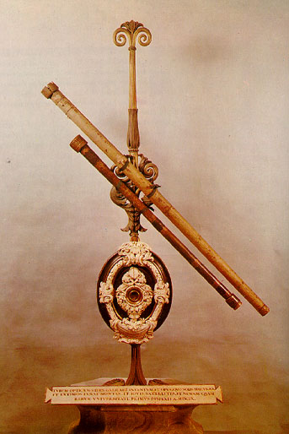
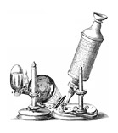
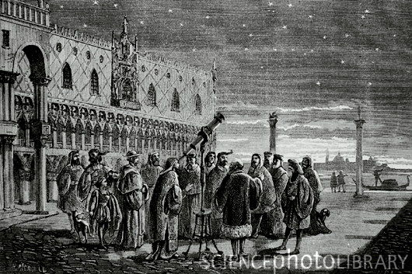
The Beginning of the Scientific Revolution
Who invented it What it does Why it was significant
1. Telescope The Dutch, 1608 Magnifies things at a distance.
Galileo built his, 1609 Improves human observation
Magnified 30 times. in astronomy.
Galileo observed:
Moons revolved around Jupiter.
So everything does not revolve
around the earth.
2. Microscope Robert Hooke, 1667 Magnifies small objects. Discovered plant cells.
Improves observation in
biology and medicine.

Slide 17


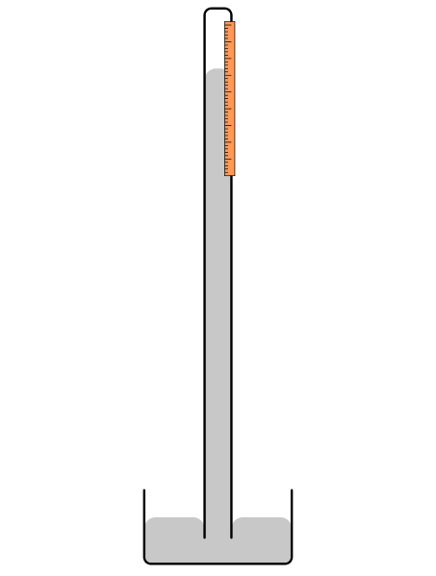
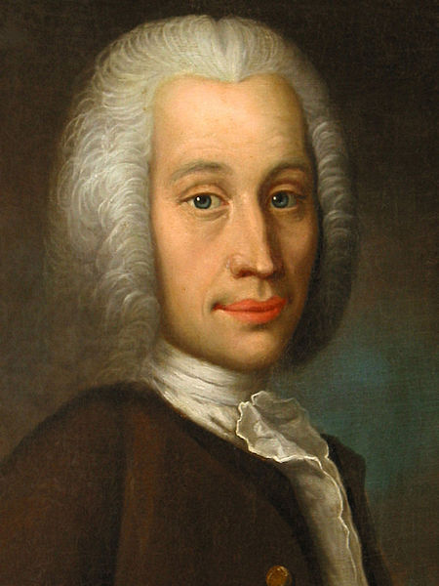
The Beginning of the Scientific Revolution
Who invented it? What it does? Why it was significant?
3. Thermometer Daniel Gabriel Fahrenheit Measures temperature. Boiling point (212);
1686 -1736 Freezing point (32)
Anders Celsius Boiling point (100)
1701-1744 Freezing Point (0)
4. Barometer Evangelista Torricelli 1645 Measures atmospheric It allows you to forecast Gasparo Berti 1600 ?? pressure. the weather.
When the barometer falls
dramatically, you are in for
bad weather
A face only a mother could love!

Slide 18
The Beginning of the Scientific Revolution
Francis Bacon 1561-1625 “Father of the Scientific Method”
Scientists must conduct experiments in the laboratory!
Systematic experimentation can reveal all the laws of nature.
Francis Bacon was also a major political leader in England.
He inspired the Royal Society in London and the Academy of Sciences in Paris.
Pull
Pull
Learning Targets
Understand the scientific method advanced by Bacon and Descartes
To understand the influence of new scientific rationalism on the growth of democratic ideas
To Understand the coexistence of science with traditional religious beliefs.
Pull
Pull

Slide 19
The Beginning of the Scientific Revolution
Descartes 1596-1650 Man is capable of reason and logic!
Scientists must doubt everything.
Scientists must behave like mathematicians.
A mathematician uses pure reason:
He figures out a math problem.
He goes wherever the numbers lead him.
He is never influenced by prejudice.
Famous quotation: “I think, therefore I am.” (Only humans have the power to use reason and logic.)
Descartes is regarded as the “Father of Modern Philosophy.”
Pull
Pull
The Scientific Method
The new way
The Scientific Method is a systematic way to conduct all experiments.
You must conduct all experiments in these steps and in this order:
1. State your theory. This can be the “accepted knowledge” that everybody believes.
2. Run an experiment To test your theory!
3. Observe the experiment. Don’t rely on the human eye. Use scientific instruments (telescope, microscope)
4. Record the results. Use math.
5. Make general statements. Use math to test your logic!
6. Draw conclusions. Is the theory true?
Pull
Pull

Slide 20
The Beginning of the Scientific Revolution
Two problems loom ahead . . .
Religion
The Protestant Reformation (1500s) told people to ignore past traditions.
The Scientific Revolution (1600s) told people to ignore past traditions.
The Catholic Church, the home of tradition, was not happy.
For starters, it believed that God made Earth the center of the universe. Any other belief was heresy.
This is why the Inquisition forced Galileo to recant (take back what he said).
Pull
Pull
Politics
Scientists believed that the world was a brilliant machine that operated according to natural laws.
Using the Scientific Method, one could discover the laws.
During the Enlightenment (1700s), politicians tried to discover “natural laws” for humans and society.
During the English Revolution (1688), John Locke came up with a lovely “natural law.”
During the American Revolution (1776), his “natural law” was a great success.
During the French Revolution (1789), all heck broke loose. Humans do not operate like machines.
Pull
Pull

Slide 21
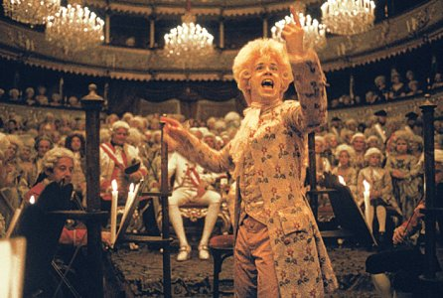

The Beginning of the Enlightenment

Slide 22
The Beginning of the Enlightenment
What was the Enlightenment?
As the teacher tells the story, students fill in the graphic organizer.
When & Where
The Enlightenment began in the late 1600s
The Enlightenment affected England, the U.S., and France.
It shaped three revolutions:
The English Revolution (1688), the American Revolution (1776), the French Revolution (1789)
What
It was the Age of Reason
Philosophers used reason to examine human affairs - politics and economics.
They loved education and free speech.
They believed in human progress.
They scorned ignorance and superstition, emotion and passion.
Pull
Pull
Who
Most were political philosophers
1. John Locke 1689 England Two Treatises of Government. Natural Rights, The Social Contract.
2. Montesquieu 1748 France The Spirit of the Laws. Rights of the minority.
3. Thomas Jefferson 1776 U.S. Declaration of Independence. All men are created equal.
4. James Madison 1787 U.S. The U.S. Constitution Separation of Powers
One was an economist
5. Adam Smith 1776 Scotland The Wealth of Nations. “Father of Modern Economics.”
Pull
Pull

Slide 23
The Beginning of the Enlightenment
How
Philosophers wrote books
They condemned tyranny and and social injustice.
They condemned people in authority - the government and the church.
Their ideas sparked two revolutions - the American Revolution and the French Revolution.
Pull
Pull
Why
During the Enlightenment (1700s), philosophers wanted to make progress and improve the world.
During the English Revolution (1688), John Locke came up with “Natural Rights” and the “Social Contract.”
During the American Revolution (1776), Thomas Jefferson wrote “All men are created equal.”
During the French Revolution (1789), all heck broke loose.
People did not always operate on reason. The Paris mob operated on passion and emotion.
Pull
Pull

Slide 24
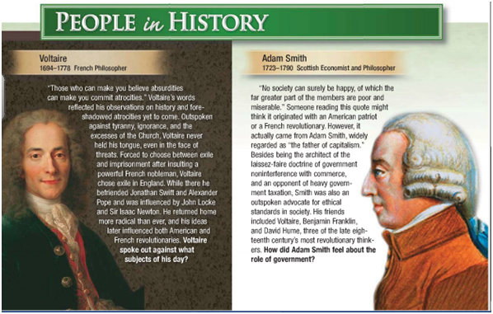
The Beginning of the Enlightenment

Slide 25
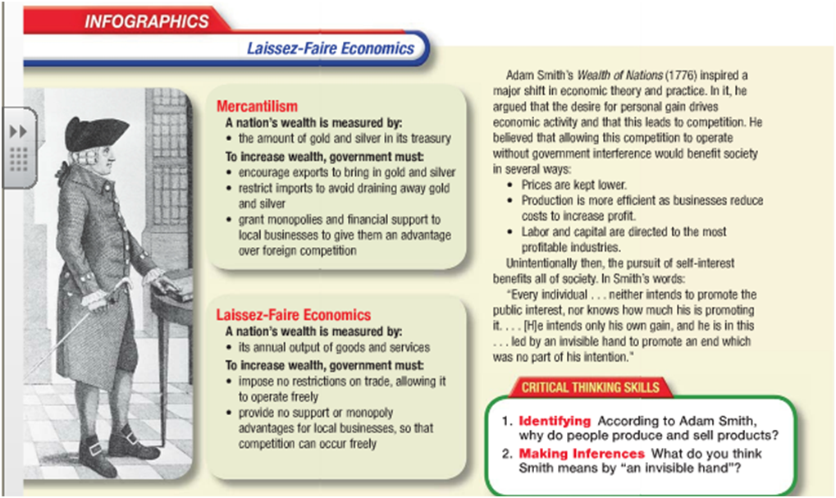
The Beginning of the Enlightenment

Slide 26
The Beginning of the Enlightenment
Capitalism
Capitalism, laissez-faire economics, and a market economy are all the same things.
Laissez-faire
Around 1750, French economists put forward a new idea.
No more government interference in the economy
Theory: Free trade!
The French economists demanded a policy of laissez-faire.
That’s French for “Hands off!”
The government must stop meddling in foreign trade.
In particular, end tariffs - a tax on imports.
Pull
Pull
Adam Smith
Adam Smith was an economist who lived in Scotland.
He was the first economist to advocate laissez-faire capitalism.
He is regarded as the “Father of Modern Economics.”
The Wealth of Nations
In 1776, he wrote his famous book, The Wealth of Nations.
In it, he condemned mercantilism. No more government control of the economy!
Instead, he advocated capitalism:
1. Let the market make economic decisions.
2. Let supply and demand (sellers and buyers) have freedom to “do their own thing.”
3. Free trade! (It will make a country rich.)
Pull
Pull

Slide 27
The Invisible Hand
Just as Newton discovered the Law of Gravity . . .Adam Smith tried to discover the Law of Economics:
The government should take its “hands off” the economy.
“The Invisible Hand” of the market would run the economy. (This bizarre idea makes a great cartoon.)
Translation: Buyers and sellers (not government) would make all economic decisions.
England: The world’s first capitalist country
England was influenced by Adam Smith’s book: It abandoned mercantilism.
England was the world’s first capitalist country. This is why it led the Industrial Revolution.
The Beginning of the Enlightenment
Pull
Pull
Capitalism
Capitalism is an economic system controlled by individuals and private companies. (Not government.)
Free enterprise Companies make their own decisions - without government interference.
Free competition Companies compete with each other - without government interference.
Free trade Companies export and import - without government interference.
A market economy The marketplace decides what people make and sell. (Not government.)
The Law of Supply & Demand
1. Supply: You make something and try to sell it in the marketplace.
2. Demand: People either buy it (profits) or they don’t (bankruptcy).
Profits & Risk
Capitalism is full of risk: The company’s owner and investors take a big risk in the marketplace.
Government never bails you out.
Pull
Pull

Slide 28
The Enlightenment
Montesquieu: The Spirit of the Laws, 1748
"In a true state of nature, all men are born equal.”
In 1787, what book did James Madison read before writing the U.S. Constitution?
Montesquieu’s The Spirit of the Laws (1748).
Madison and the founding fathers put many of Montesquieu’s ideas into the U.S. Constitution!
Pull
Pull
Montesquieu
Montesquieu was a political philosopher who lived in France.
Montesquieu was “enlightened”:
He did not go along with French tradition - absolute monarchy and the divine right of kings.
Instead, he tried to discover the natural laws that lie beneath government.
* See Handout
Pull
Pull

Slide 29
The Enlightenment: The Impact
The Declaration of Independence, 1776
THE DECLARATION OF INDEPENDENCE
Ask one student to read this document aloud . . .
When in the Course of human events, it becomes necessary for one people to dissolve the
political bands which have connected them with another, and to assume among the powers of the earth, the
separate and equal station to which the Laws of Nature and of Nature's God entitle them, a decent respect to
the opinions of mankind requires that they should declare the causes which impel them to the separation.
We hold these truths to be self-evident, that all men are created equal (1), that they are endowed by their
Creator with certain unalienable Rights (1), that among these are Life, Liberty, and the pursuit of Happiness (1).
That to secure these rights, Governments are instituted among Men (2), deriving their just powers from the
consent of the governed (2). That whenever any Form of Government becomes destructive of these ends (2), it
is the Right of the People to alter or to abolish it (2), and to institute new Government, laying its foundation on
such principles and organizing its powers in such form, as to them shall seem most likely to effect their Safety
and Happiness.
Prudence, indeed, will dictate that Governments long established should not be changed for light and transient
causes; and accordingly all experience hath shewn, that mankind are more disposed to suffer, while evils are
sufferable, than to right themselves by abolishing the forms to which they are accustomed.
But when a long train of abuses and usurpations, pursuing invariably the same object evinces a design to
reduce them under absolute Despotism, it is their right, it is their duty, to throw off such Government, and to
provide new Guards for their future security.

Slide 30
The Enlightenment: The Impact
CLASS DISCUSSION
1. What is the big idea?
2. What is the main purpose of government?
By what authority does the government make laws for you and me?
What if the government does carry out its main purpose?
Two Ideals
1. Natural Rights
All men are created equal.
Each person has natural, God-given rights (life, liberty, pursuit of happiness).
2. The Social Contract
The main purpose of government is to protect the individual person’s rights.
The people form a government to protect their rights.
So the government’s power and authority come from the people.
Government must have the consent of the governed.
Whenever government abuses the rights of the people, the people have the right to overthrow that government.

Slide 31
The Enlightenment: Rousseau - Wollstonecraft
Jean-Jacques Rousseau
Major work - The Social Contract
Through a Social Contract the entire society agrees to be governed by its general will.
Individuals who wish instead to follow their own self interest must be forced to abide by the "general will."
Emotion as well as reason were important to human development
Pull
Pull
Mary Wollstonecraft - English Writer who advanced the strongest statement of the rights of women
Book A Vindication of the Rights of Women
Pointed out that men who thought the power of kings over mankind was wrong, were hypocritical not seeing the power of men over women as the same relationship
Enlightenment ideal for all of humankind not just men
Pull
Pull

Slide 32
The Enlightenment: Reading -Salons
A great importance to the Enlightenment was the spreading of ideas to the literate elite
The number of titles issued each year by French publishers rose from 300 in 1750 to about 1600 in the 1780's
Books had previously been only targeted for educated elite, not they were spreading to the middle class which included women and urban artisans.
The first daily paper was printed in London in 1702
Pull
Pull
Salons were some of the first places where Enlightenment ideas were to be spread
Were typically elegant upper class drawing rooms
Invited guests to gather in these salons and took part in conversations that were often centered on the new ideas of the philosophes
Brought writers and artists together with aristocrats, government officials and wealthy middle class people
Marie-Therese de Geoffrin - wife of a wealthy merchant
Pull
Pull

Slide 33
The Enlightenment: Austria - Joseph II
Enlightenment thought influenced European politics in the 18th century
Philosophes believed in natural rights for all people
Ex. equality before the law, freedom of religious worship, freedom of speech
Enlightenment Absolutism - Rulers tried to govern by Enlightenment principals while maintaining their royal powers.
The Austrian Empire - One of the great European states by the start of the 18th century.
Hard to rule because of its unique make-up. Sprawling empire, many nationalities, languages, religions, and cultures.
Maria Theresa - inherited throne in 1740 - not open to philosophers call for change
Joseph II - " I have made Philosophy the lawmaker of my empire."
He abolished serfdom and eliminated the death penalty
Reforms largely failed, alienated the nobles and serfs could not understand the changes
Pull
Pull
Pull
Pull
Epitaph:
"Here lies Joseph II who was unfortunate in everything he undertook."
His successors undid almost all of his reforms

Slide 34
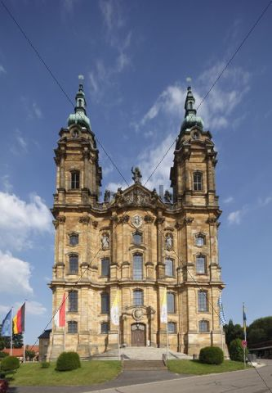
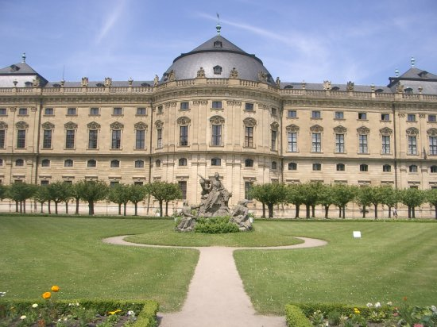
The Eighteenth Century was a great period in the history European Architecture, Art, Literature, and Music
The grand style of Versailles provided an enormous inspiration for many monarchs who like the opulence Versailles brought.
Many palaces also modeled after the Italian Baroque style of the 15th and 16th century's
This new blend of baroque and neoclassical styles stressed grace, charm, and gentile action, it was called Rococo
Highly secular and utilized gold with graceful curves
Two famous Rococo artist were Antoine Watteau and Giovani Battista
Pull
The Enlightenment: Architecture and Arts
Pull
Great Architect's of the 18th century was Balthasar Neumann
Two greatest works: Church of the Fourteen Saints and the palace of the Prince Bishop of Wurzburg
Pull
Pull

Slide 35
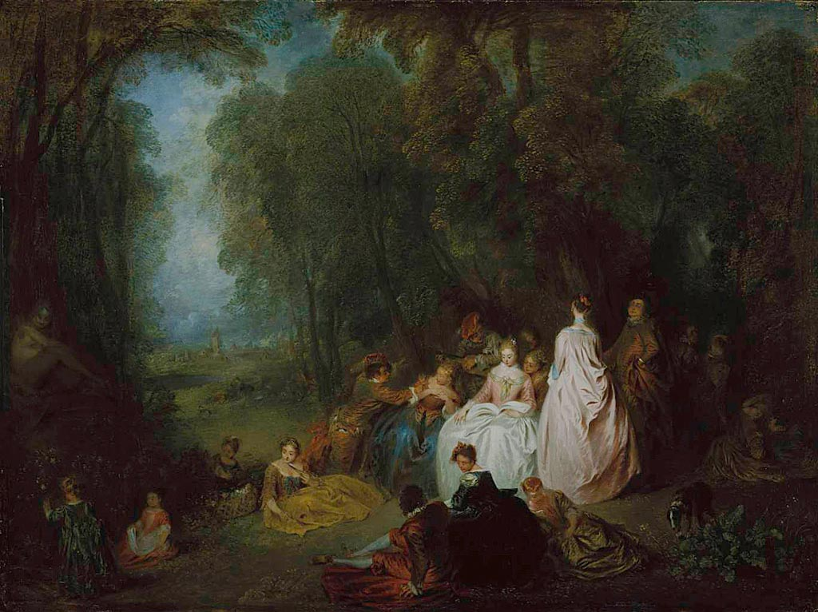
Antoine Watteau - LaFete

Slide 36
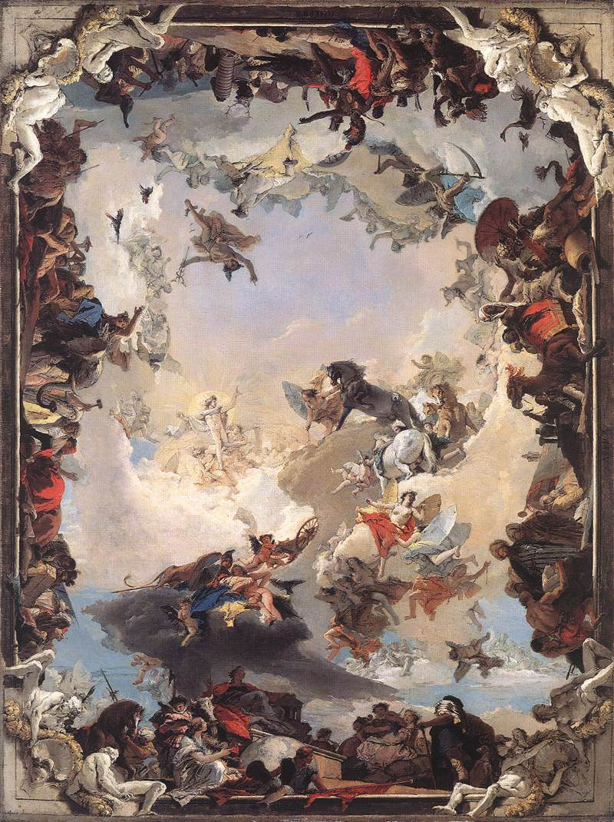
Ceiling of the bishops residence at Wurzburg largest Fresco in the world at 7,287 sq. feet
Giovanni Battista Tiepolo

Slide 37
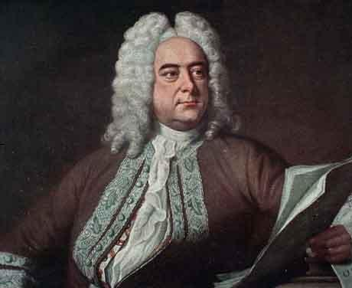
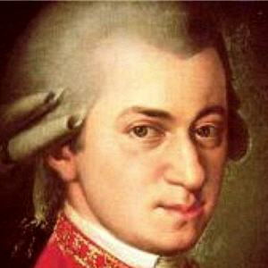
The Enlightenment: Music
The 18th century produced two of the greatest musical geniuses known to man Mozart and Handel
Handel was German who spent much of his career in England
His works were secular but some of his best known work is religious
Baroque Style Music
Handel wrote Messiah
In the second half of the 18th century two composers create a shift from Baroque style to music called Classical, they were Haydn and Mozart
Mozart was a child prodigy who gave his first harpsichord concert at age 6
Famous works are The Marriage of Figaro, the Magic Flute, and Don Giovanni
Pull
Pull
Handel
Mozart

Slide 38
The American Revolution: British
The United Kingdom of Great Britain came into existence 1707 when the governments of England and Scotland were united
The term "British" them came to refer to both the English and Scots
Lets review the 7 Years War?
Was fought in 3 main places - Europe - India and in North America
The greatest conflicts took place in North America - Fought between France and England
English eventually are victorious at the Plains of Abraham in Quebec
Treaty of Paris - effectively ends the war and transfers French Canada and the lands east of the Mississippi to the English
By 1763 Great Britain had become the worlds greatest colonial power
Pull
Pull

Slide 39
The American Revolution: British
Big Question?
How would the end of the 7 Years War and the Treaty of Paris effect the revolutionaries relationship with France?
Who did the French help in the war and why?
Pull
Pull

